Slide 1
Morning session: overview
Unsupervised learning: dimension reduction and data integration
Principal Component Analysis (PCA)
Maximal variance principle
Partial Least Squares (PLS)
Maximal covariance principle
Two-way Orthogonal PLS (O2PLS)
Multi-omics data integration

Slide 2
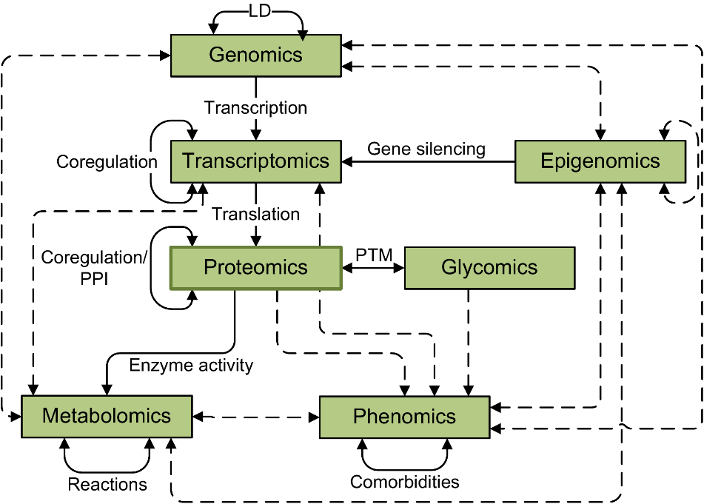
Background
Recent advances in technology provided many types of biological datasets (multi-omics data)
Different levels of biological variation measured
Need for integrative approaches: combine data and extract information

Slide 3
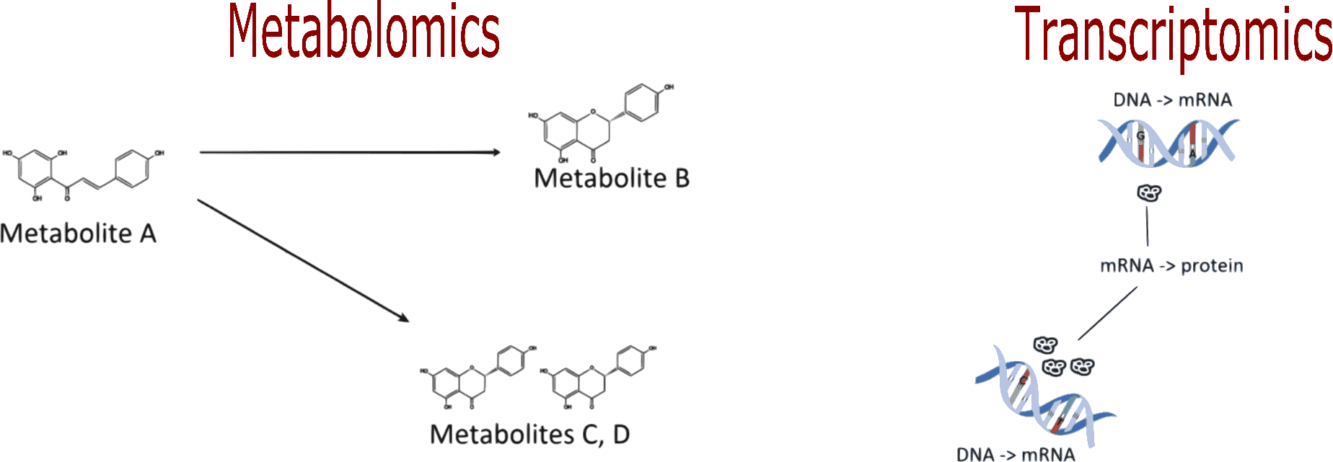
Integrative approach: aims
How does variation between omics datasets relate?
Which types of features induce this variation?
Can we benefit from a joint/integrative analysis?

Slide 4
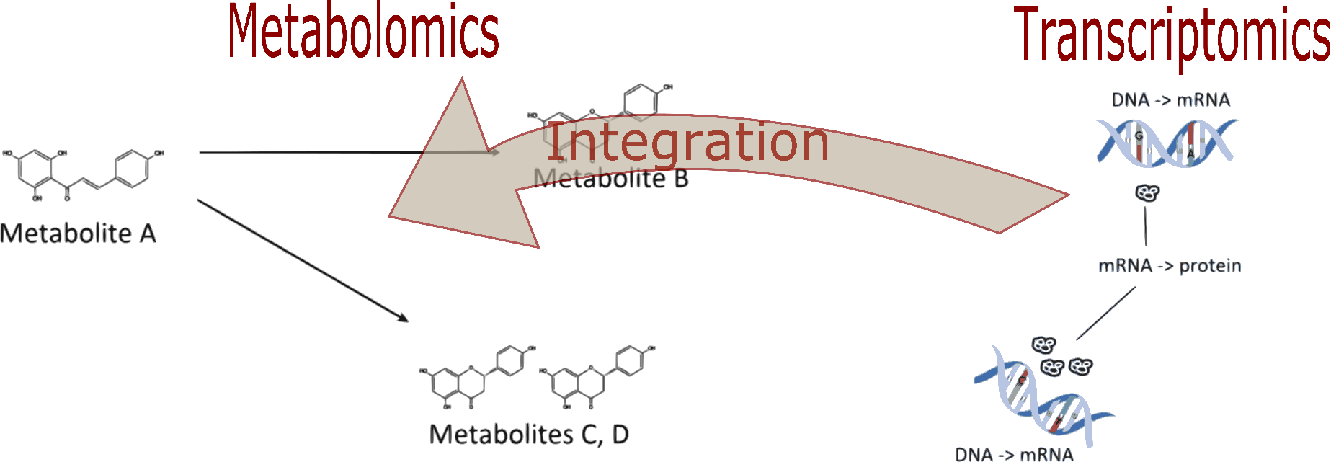
Integrative approach: aims
How does variation between omics datasets relate?
Which types of features induce this variation?
Can we benefit from a joint/integrative analysis?

Slide 5
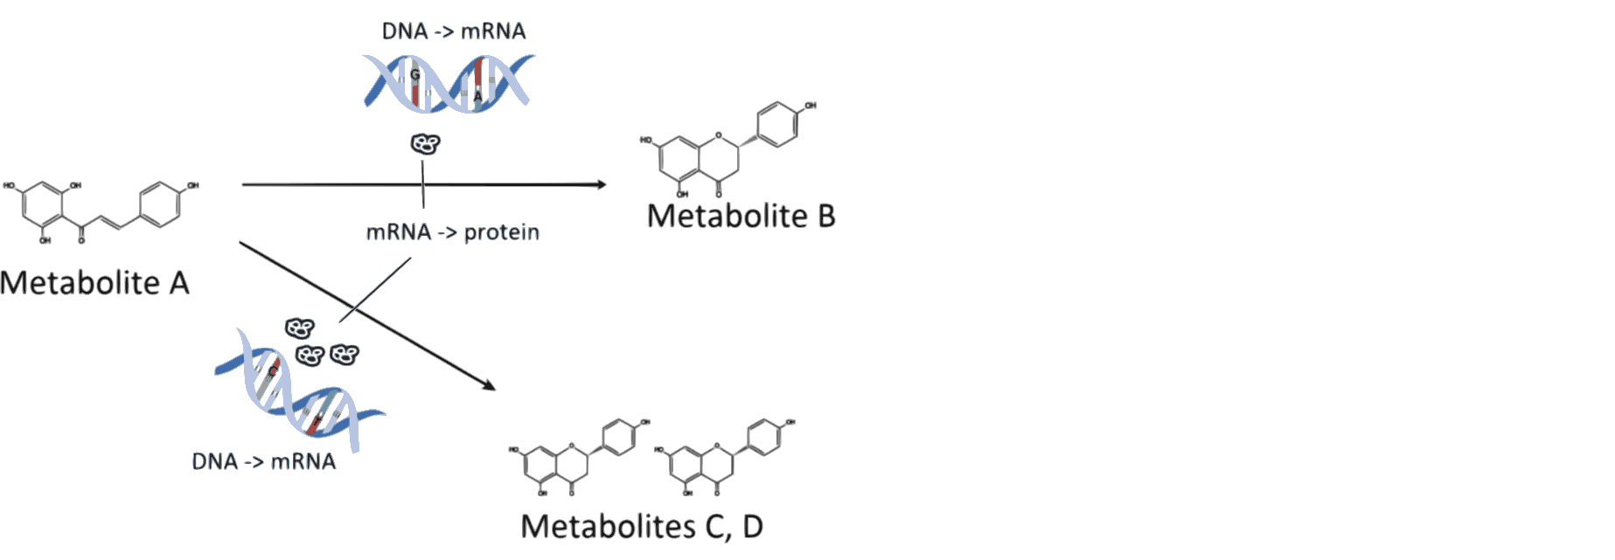
Integrative approach: aims
How does variation between omics datasets relate?
Which types of features induce this variation?
Can we benefit from a joint/integrative analysis?

Slide 6
Integrative approaches: means
There is typically
High correlation among features
Genes are correlated
Metabolites are correlated
Relation between features from two datasets
Latent variable approach: few independent latent variables drive association

Slide 7
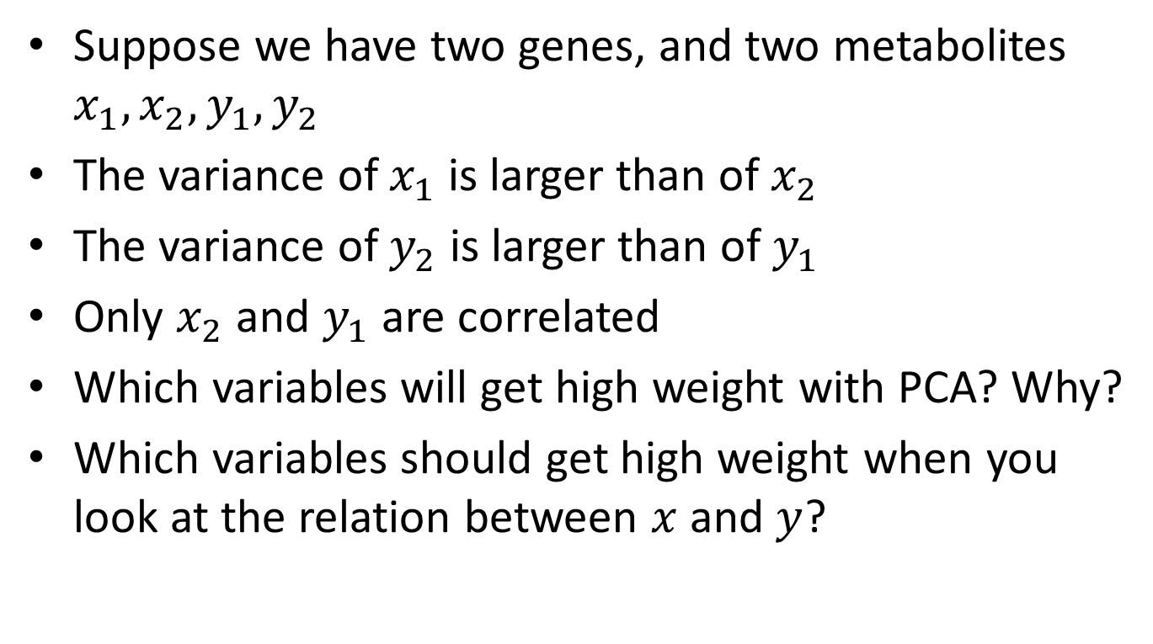
Example: bivariate data
Suppose we have two genes, and two metabolites $x_{1},x_{2}, y_{1},y_{2}$
The variance of $x_{1}$ is larger than of $x_{2}$
The variance of $y_{2}$ is larger than of $y_{1}$
Only $x_{2}$ and $y_{1}$ are correlated
Which variables will get high weight with PCA? Why?
Which variables should get high weight when you look at the relation between $x$ and $y$?

Slide 8
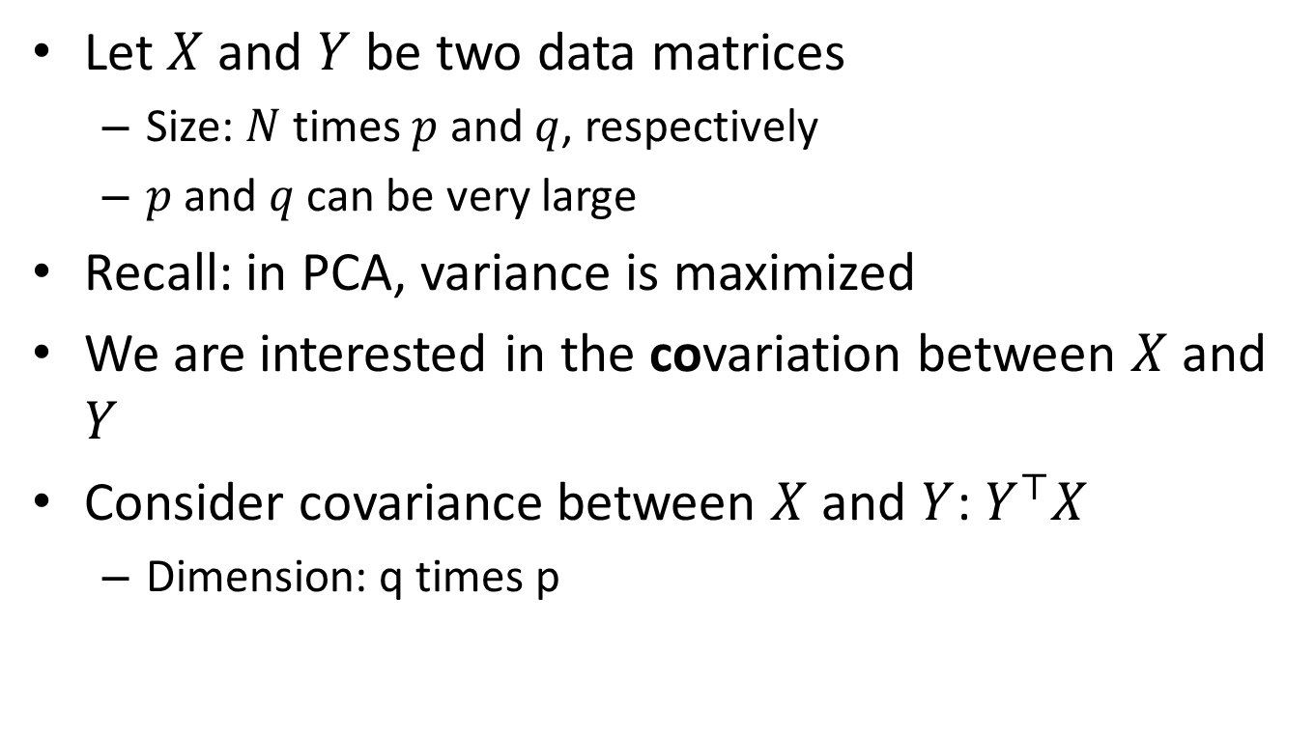
Partial Least Squares (PLS)
Let $X$ and $Y$ be two data matrices
Size: $N$ times $p$ and $q$, respectively
$p$ and $q$ can be very large
Recall: in PCA, variance is maximized
We are interested in the covariation between $X$ and $Y$
Consider covariance between $X$ and $Y$: $Y^{⊤}X$
Dimension: q times p

Slide 9
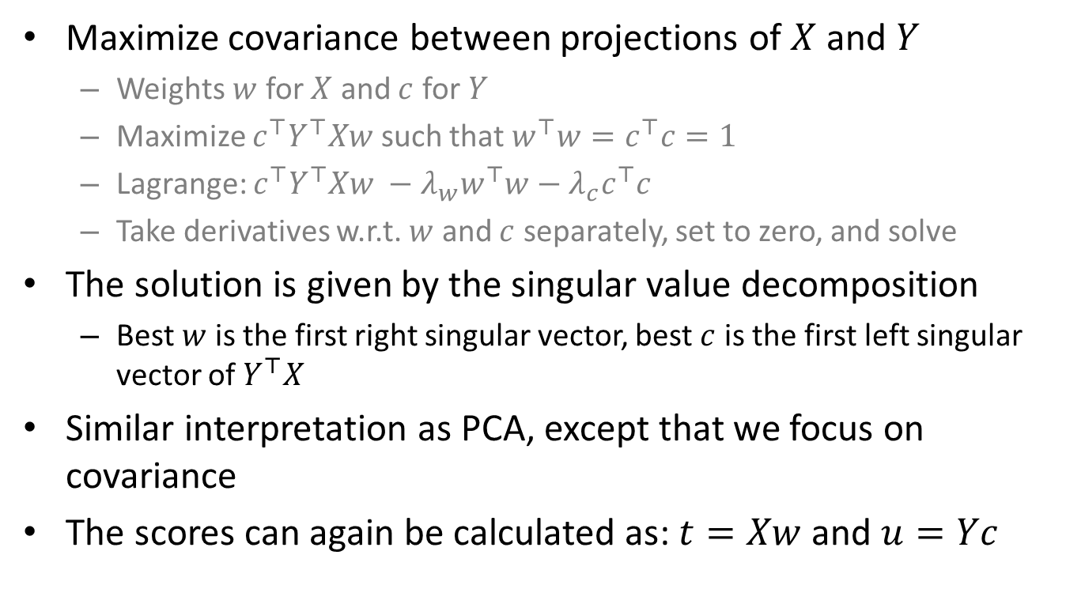
Partial Least Squares (PLS)
Maximize covariance between projections of $X$ and $Y$
Weights $w$ for $X$ and $c$ for $Y$
Maximize $c^{⊤}Y^{⊤}Xw$ such that $w^{⊤}w=c^{⊤}c=1$
Lagrange: $c^{⊤}Y^{⊤}Xw −λ_{w}w^{⊤}w−λ_{c}c^{⊤}c$
Take derivatives w.r.t. $w$ and $c$ separately, set to zero, and solve
The solution is given by the singular value decomposition
Best $w$ is the first right singular vector, best $c$ is the first left singular vector of $Y^{⊤}X$
Similar interpretation as PCA, except that we focus on covariance
The scores can again be calculated as: $t=Xw$ and $u=Yc$

Slide 10
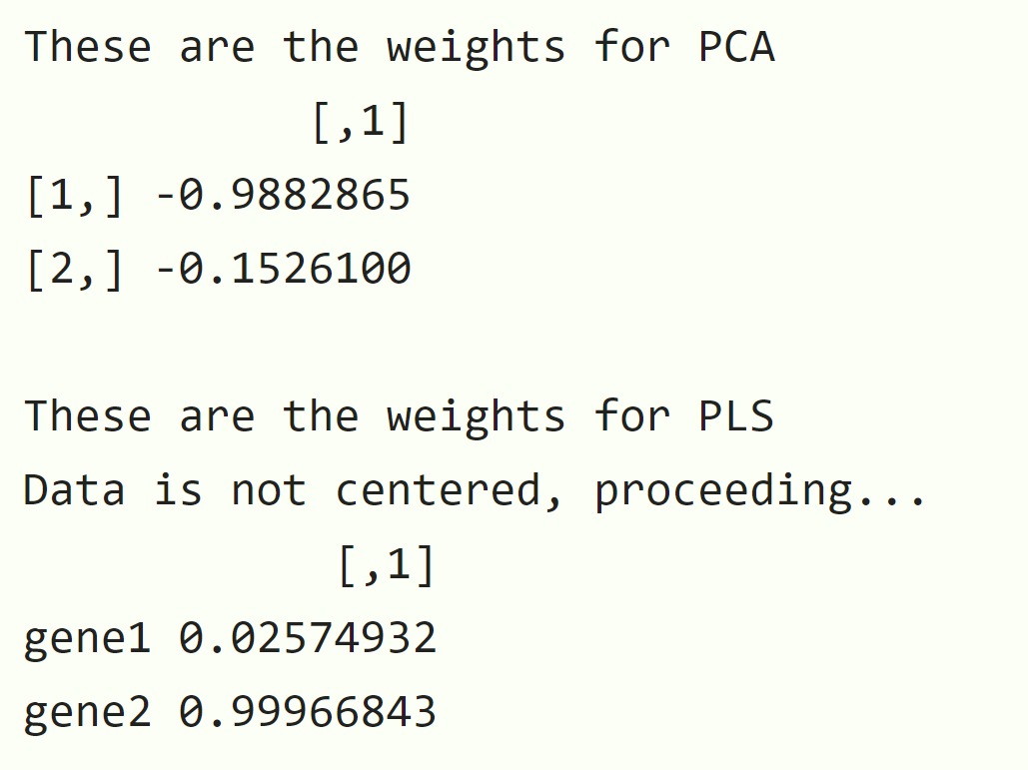
Example: PLS
library(OmicsPLS)
gene1 <- rnorm(100)
gene2 <- rnorm(100,sd=0.75)
metab1 <- rnorm(100)
metab2 <- gene2
X <- cbind(gene1, gene2)
Y <- cbind(metab1, metab2)
svd(X,0,1)$v
o2m(X, Y, 1, 0, 0)$W.

Slide 11
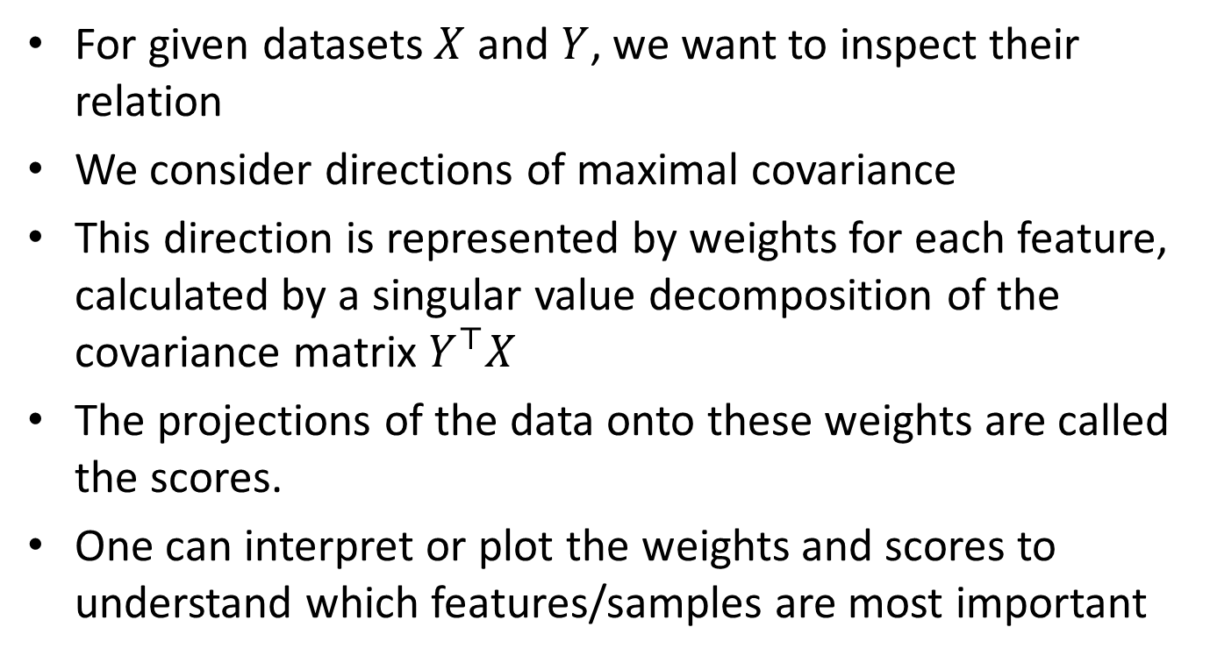
Partial Least Squares: summary
For given datasets $X$ and $Y$, we want to inspect their relation
We consider directions of maximal covariance
This direction is represented by weights for each feature, calculated by a singular value decomposition of the covariance matrix $Y^{⊤}X$
The projections of the data onto these weights are called the scores.
One can interpret or plot the weights and scores to understand which features/samples are most important

Slide 12
Morning session: overview
Unsupervised learning: dimension reduction and data integration
Principal Component Analysis (PCA)
Maximal variance principle
Partial Least Squares (PLS)
Maximal covariance principle
Two-way Orthogonal PLS (O2PLS)
Multi-omics data integration

